Slide 1



Airbnbs in New York City
Understanding Trends

Slide 2


Overview
We aim to explore how room types, borough, neighbourhood and affect the price of AirBnB listings in New York City.
Our analysis aims to extract valuable insights using data visualization and statistical analysis.

Slide 3

Research Objectives
We would like to explore how factors such as location, room type, and price affect the booking behavior of guests and extract valuable insights for property management and marketing decisions.

Slide 4


Key Factors influencing Price
Price is a composite variable which is based on factors like Neighbourhood Type, Minimum Nights, Availability, Room Type, etc.
Tools and Packages Used
PRICE
Tools: Kaggle API, Basic Statistic
(Mean, Median, Mode, Percentage, etc)
Packages: Pandas, NumPy, Matplotlib, and Seaborn.

Slide 5


Importing the Data
Initialized and authenticated the Kaggle API to enable dataset access
Defined dataset identifier and filename for Airbnb data
Downloaded the dataset using the dataset_download_file method
Loaded the data into a Pandas DataFrame and displayed the first few rows

Slide 6
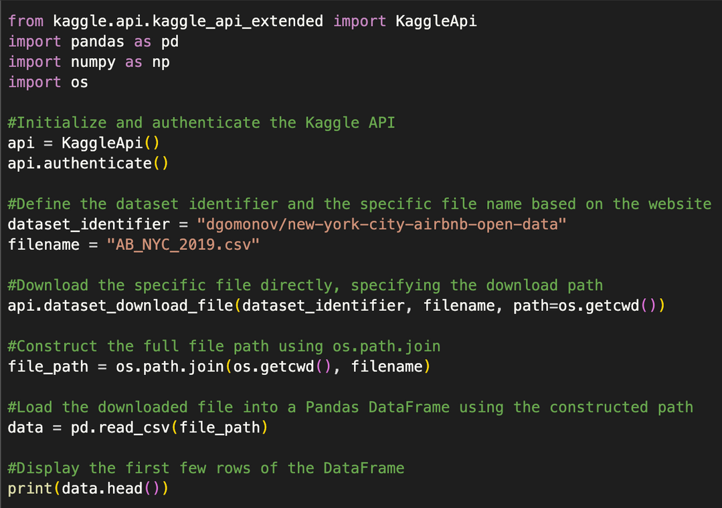
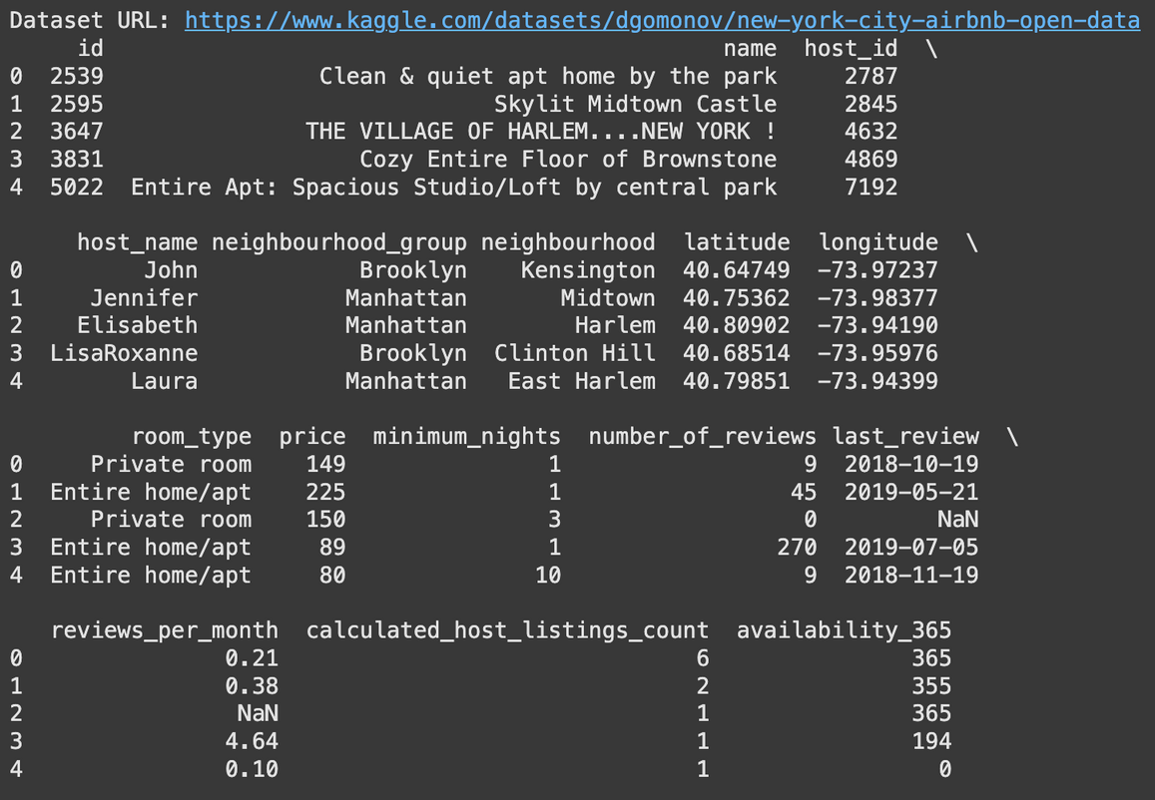
Importing the Data - Code v/s Output
Code
Output

Slide 7

Cleaning the Dataset
Checked for missing values using .isnull() method.
Found missing values in 4 columns: host_name, name, last_review, reviews_per_month
Dropped columns host_name, name, and last_review as they were not critical for analysis.
Filled missing values in reviews_per_month with 0 to maintain data consistency.

Slide 8
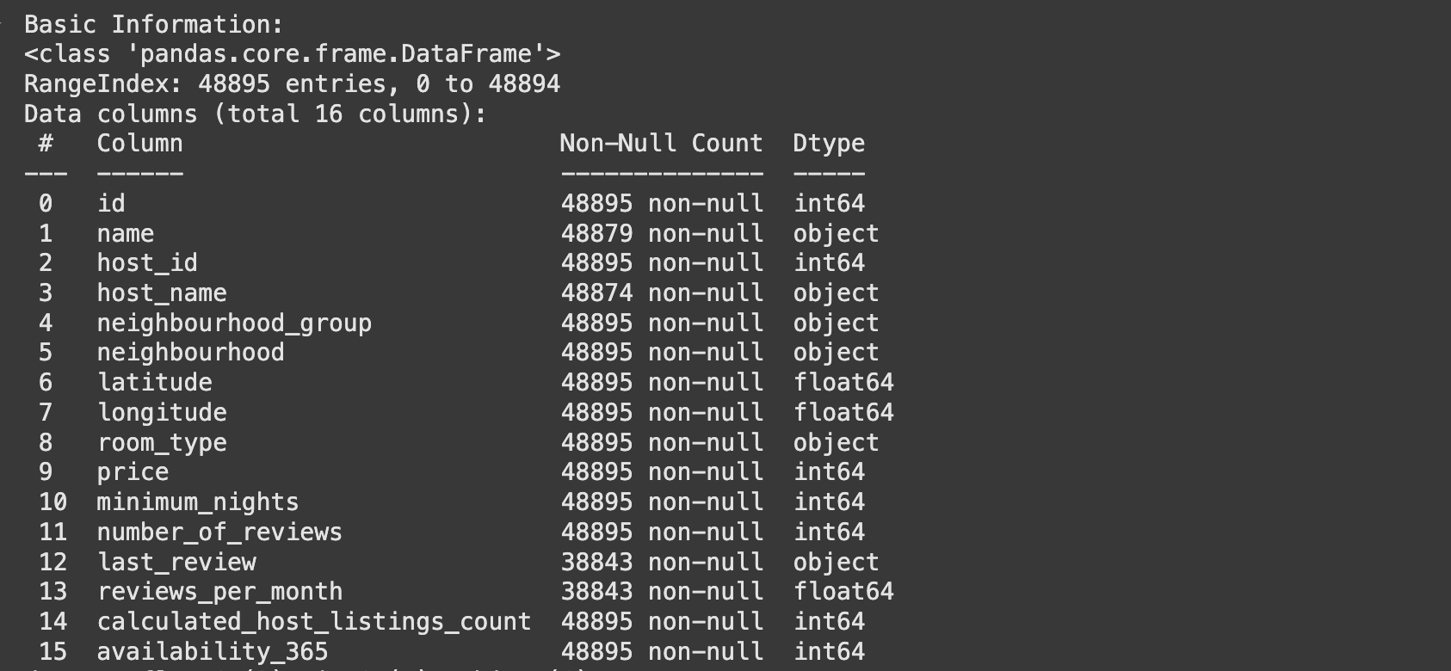
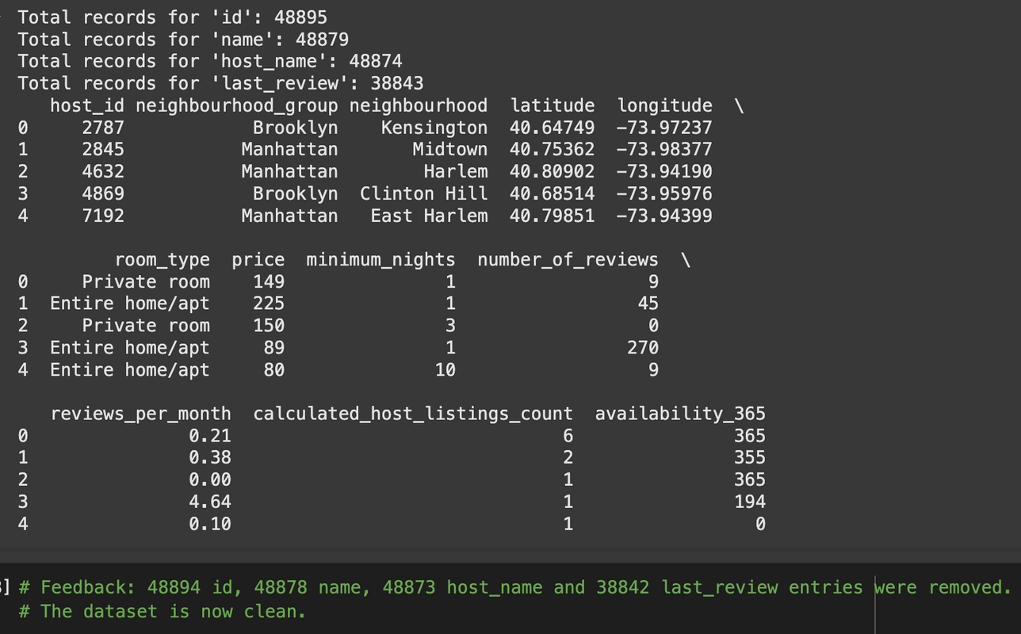
Cleaning the Dataset - Output
Data Columns
Cleaned Data

Slide 9
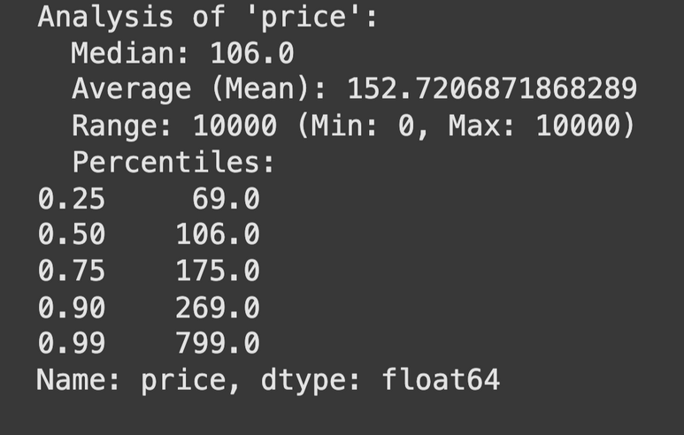
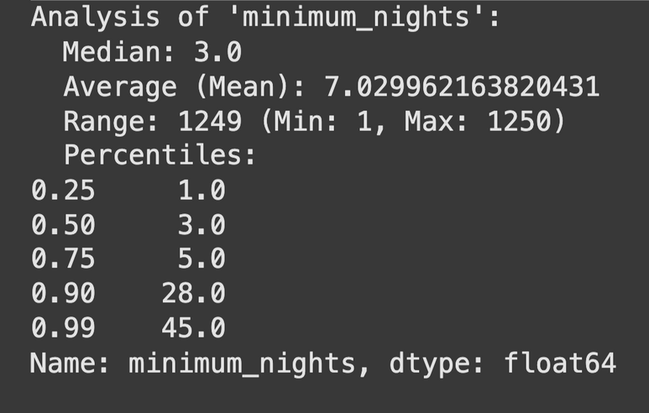
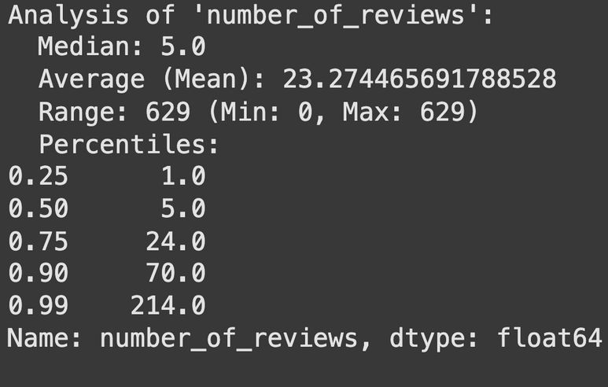
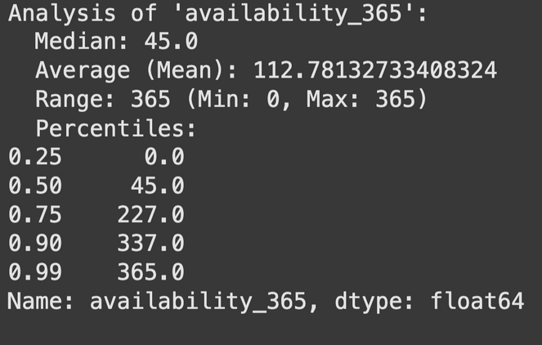
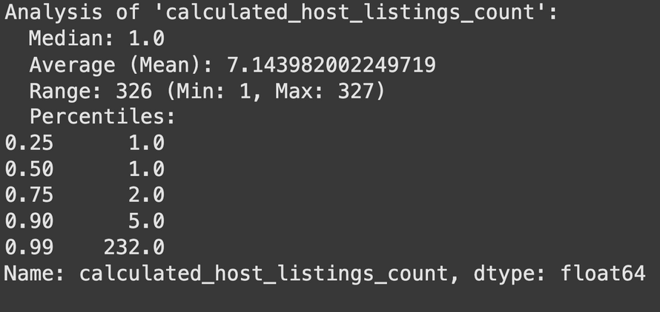
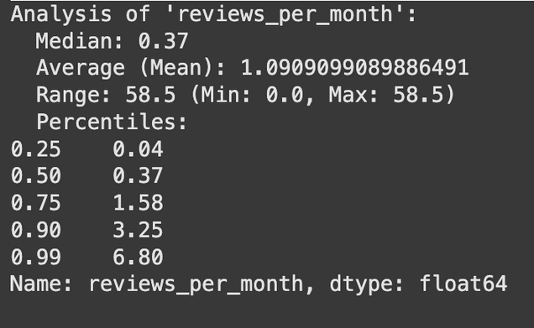
Descriptive Statistics of Variables
Exploratory Data Analysis

Slide 10
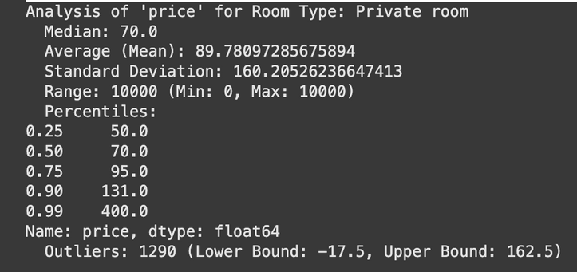
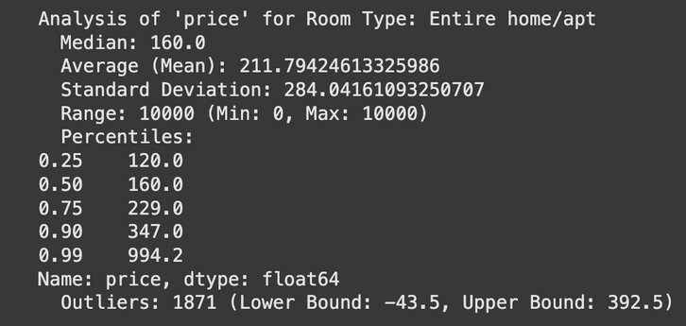
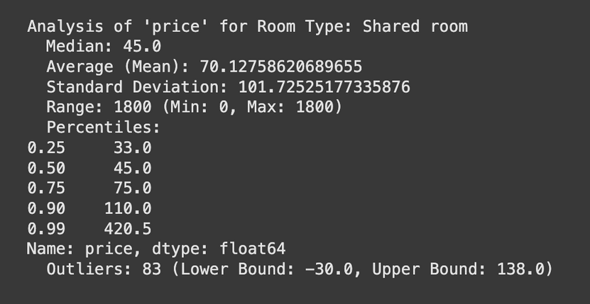
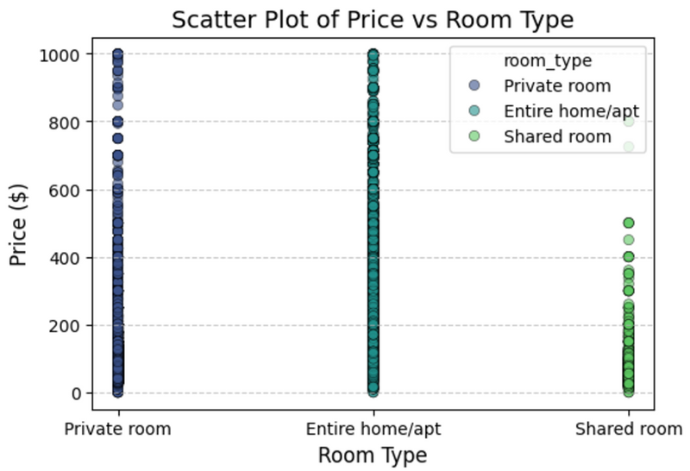
Statistical Analysis of Price with Different Room Types
We can see significant differences in pricing across different room types based on the statistical analysis:
Entire homes/apts have the highest and most variable prices, reflecting their premium features.
Shared rooms are the cheapest and most stable, ideal for budget travellers.
Private rooms offer mid-range prices with moderate variability.

Slide 11
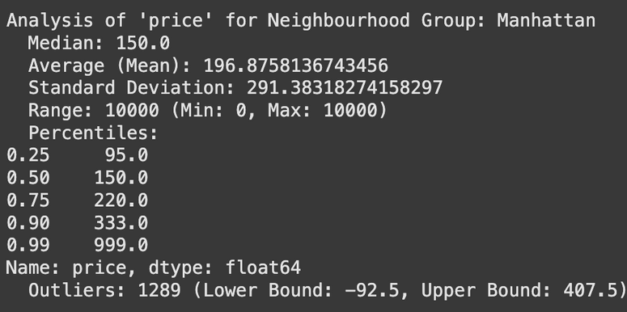
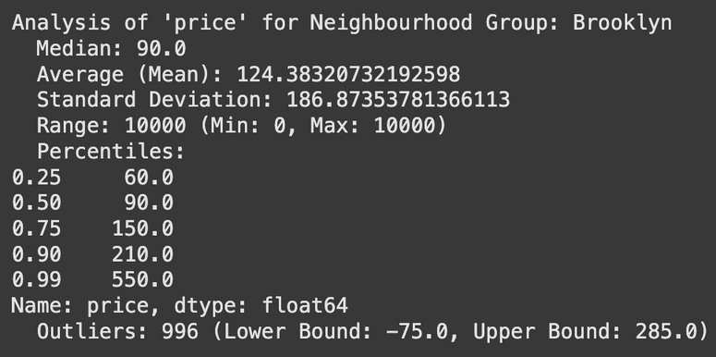
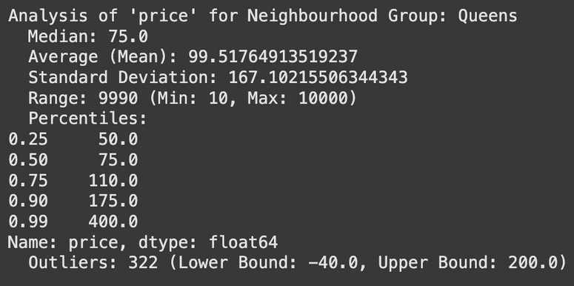
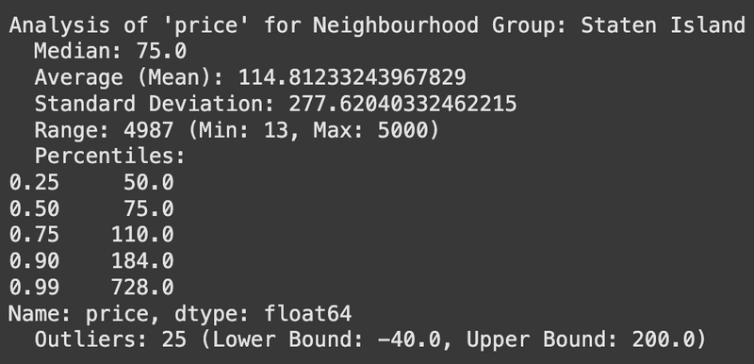
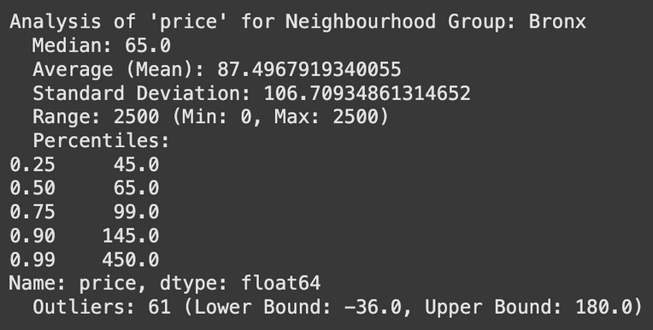
Statistical Analysis of Borough-wise Price Trends
We can see significant differences of pricing across neighbourhood groups based on the statistical analysis

Slide 12
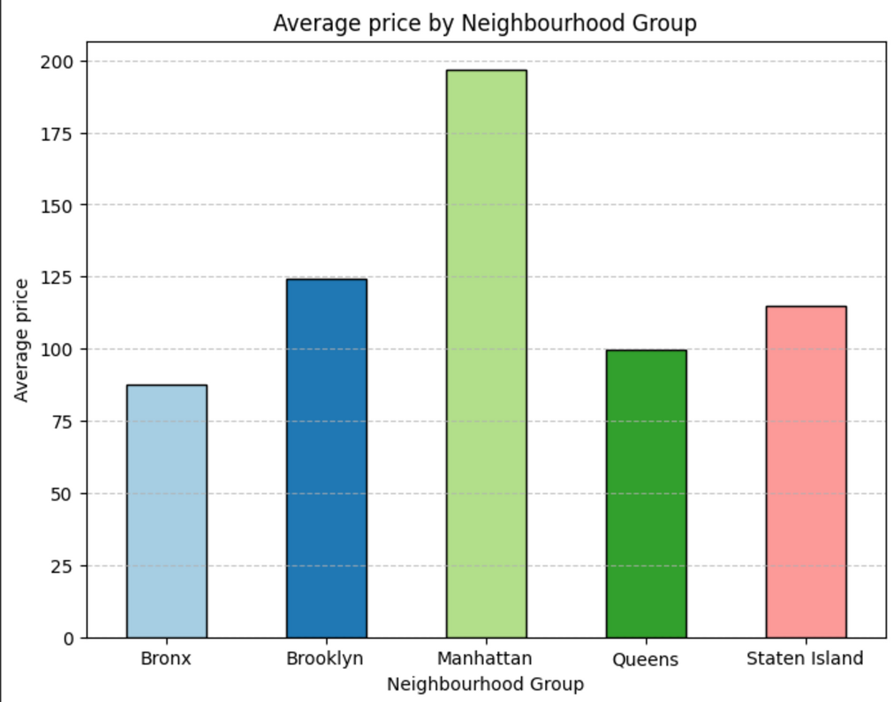
Statistical Analysis of Borough-wise Price Trends
Key Insights:
Manhattan dominates in pricing, indicating its high-end appeal
Bronx and Queens offer the most affordable options
Brooklyn strikes a balance between affordability and luxury
Staten Island provides varied pricing but is less competitive compared to Manhattan and Brooklyn

Slide 13
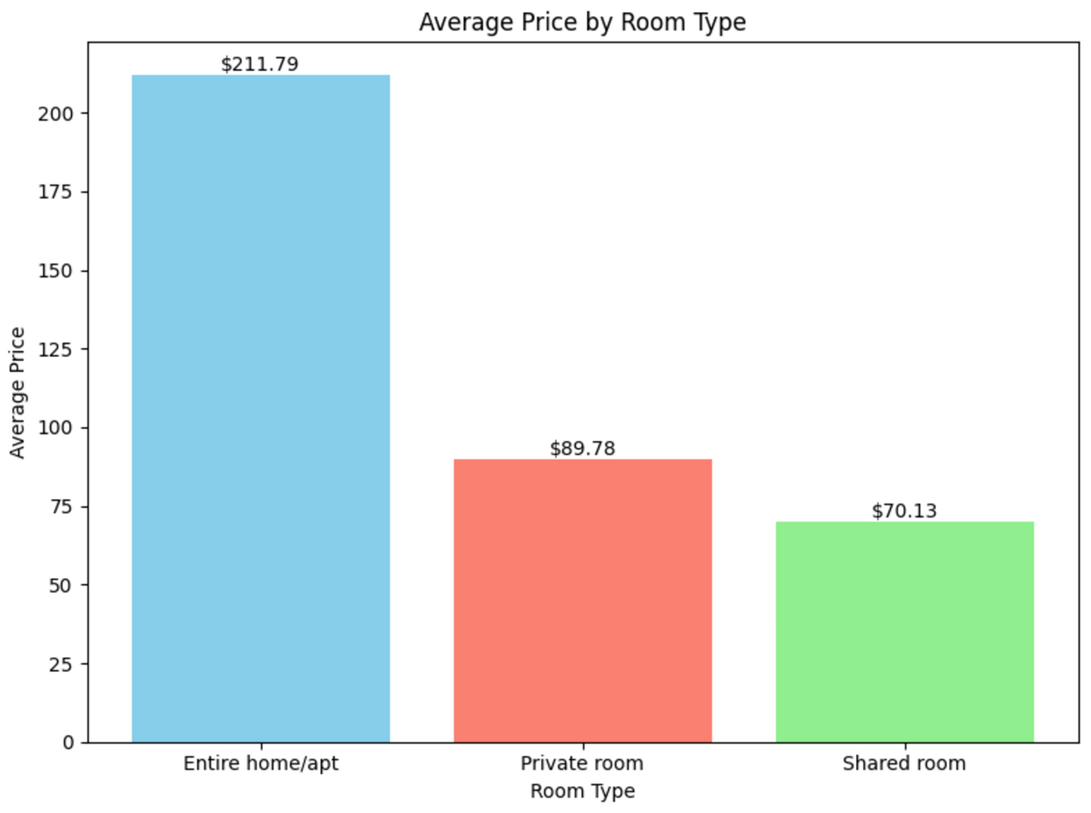
Price vs. Room Type: Visualization and Insights
The pricing distribution reflects a clear trade-off between cost and the level of exclusivity. Entire homes provide the highest level of privacy but at a premium, while shared rooms offer affordability at the expense of personal space.
The relatively modest price gap between private and shared rooms ($19.65) suggests that some travelers may opt for private rooms if they perceive the additional cost as justified by the increased comfort and privacy.
The wide price disparity between entire homes and other room types suggests that entire homes target a distinctly different audience compared to private or shared rooms, emphasizing the segmentation in the market.

Slide 14
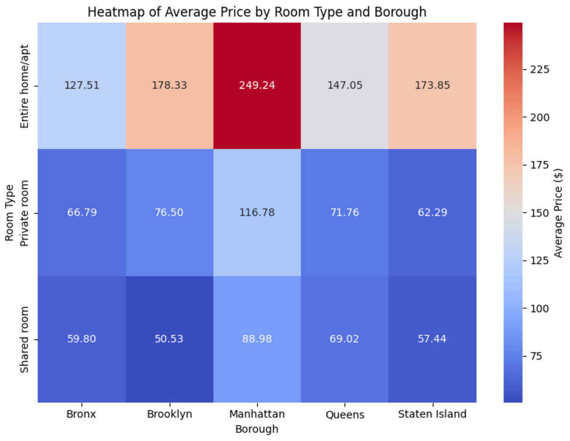
Heatmap: Average Price by Room Type and Borough
Manhattan has the highest prices for all room types, with entire homes averaging $249.24, making it the most expensive borough.
Staten Island and the Bronx are the most affordable, with shared rooms in Staten Island costing $57.44.
Brooklyn and Queens offer a balance of affordability and proximity to Manhattan, with mid-range prices for all room types.
The stark price differences between Manhattan and the outer boroughs highlight the impact of location desirability and demand, with Manhattan dominating the luxury market.

Slide 15
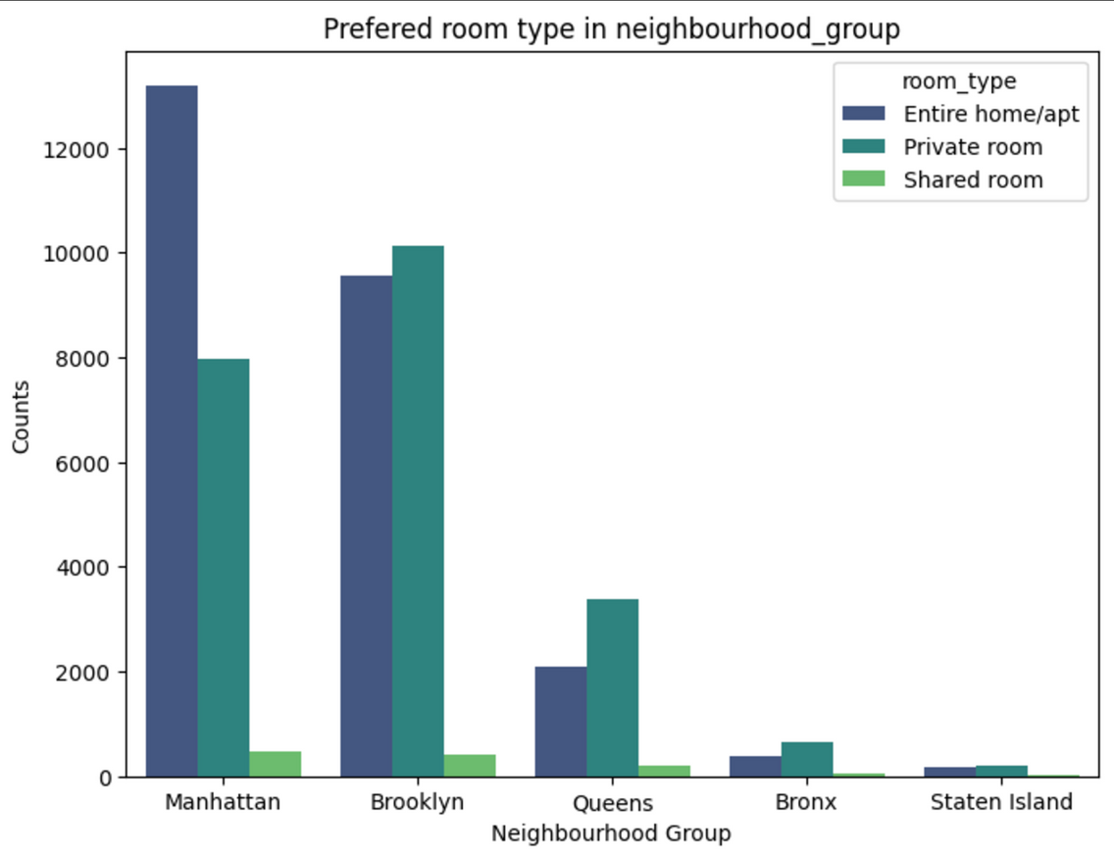
Count of Room Types by Boroughs
Entire home/apt is the most preferred room type in the more prominent boroughs (Manhattan and Brooklyn), likely due to higher tourist demand for privacy and comfort.
Private rooms are more common in boroughs with lower listing volumes or where affordability is a key factor (e.g., Queens and Bronx).
Shared rooms consistently have the lowest counts, suggesting limited demand for shared accommodations across all boroughs.

Slide 16
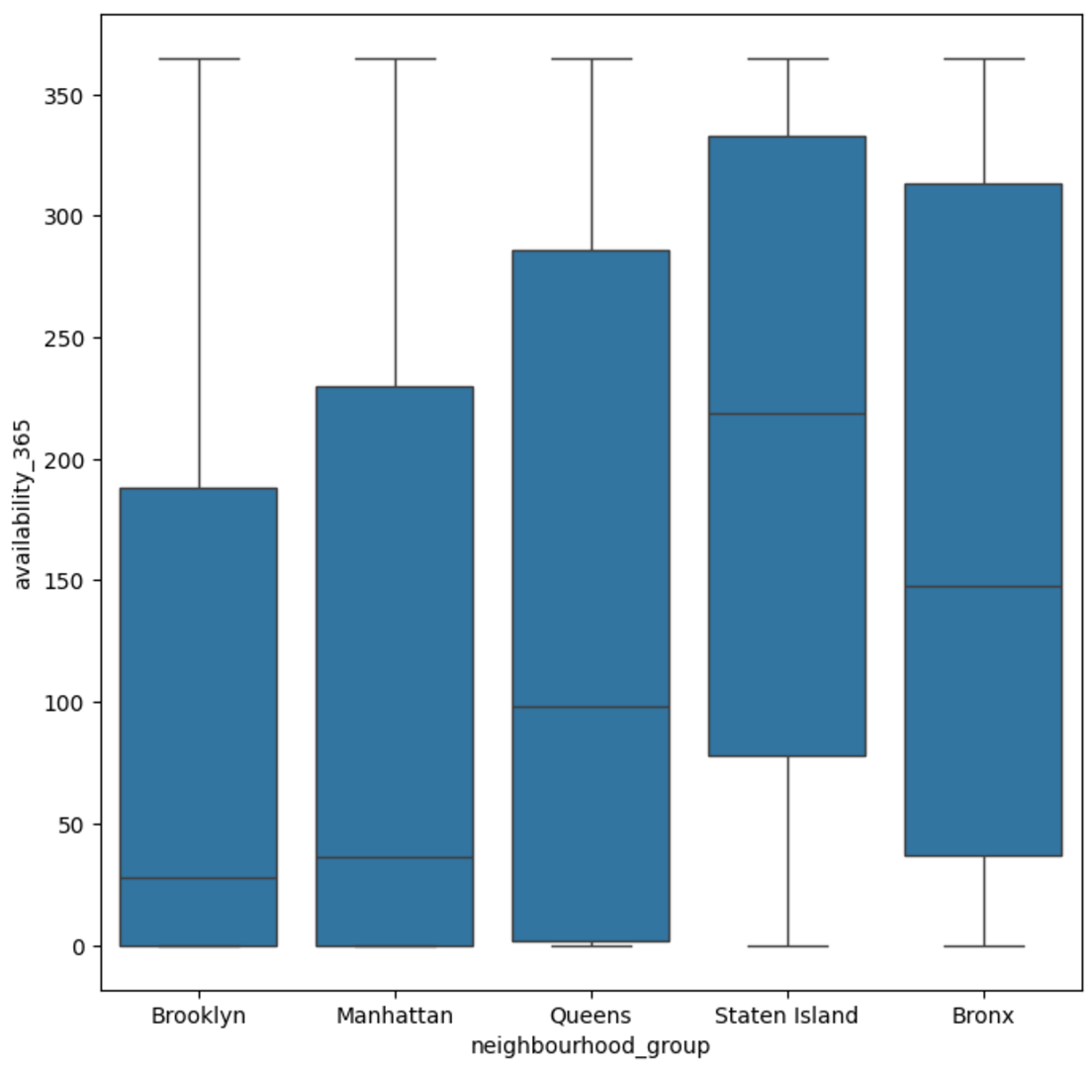
Boxplot: Availability Trends across Boroughs
The availability of Airbnb listings varies significantly across the neighbourhood groups, with Queens and Staten Island showing generally higher availability compared to Manhattan, Brooklyn, and the Bronx
Listings in Manhattan and Brooklyn tend to have lower and more consistent availability, possibly reflecting high demand, stricter regulations, or hosts favouring short-term over year-round rentals
Staten Island and Queens exhibit higher medians and wider availability ranges, indicating many properties are available year-round, potentially due to lower competition or demand
The Bronx shows the lowest median and relatively restricted availability, suggesting fewer listings or less active participation in the Airbnb market

Slide 17
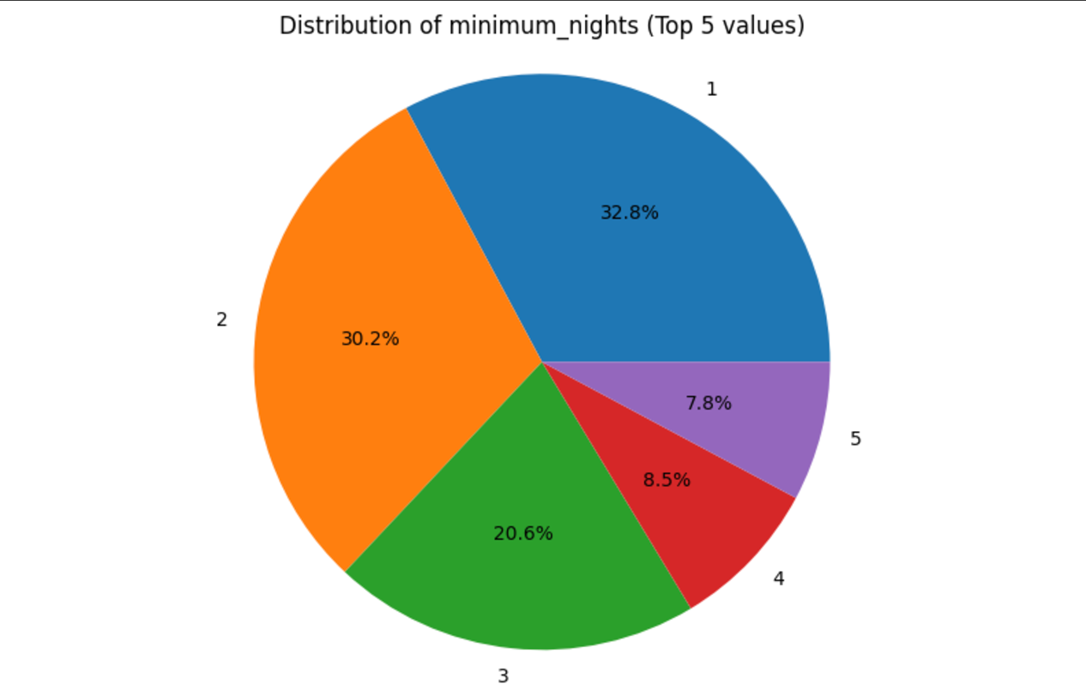
Distribution of Minimum Stay Patterns: Top 5 Values
One-night stays are the most common (32.8%), followed closely by two-night stays (30.2%), showing hosts’ preference for accommodating short-term guests.
Listings requiring 3, 4, or 5 nights account for smaller proportions, reflecting lower demand or flexibility for extended stays.
The data emphasizes that the Airbnb market heavily favors shorter booking durations.
The popularity of one- and two-night minimum stays indicates that most hosts are open to short-term rentals, catering to travelers with flexible, quick itineraries. This suggests Airbnb is primarily used for brief trips rather than extended visits.

Slide 18
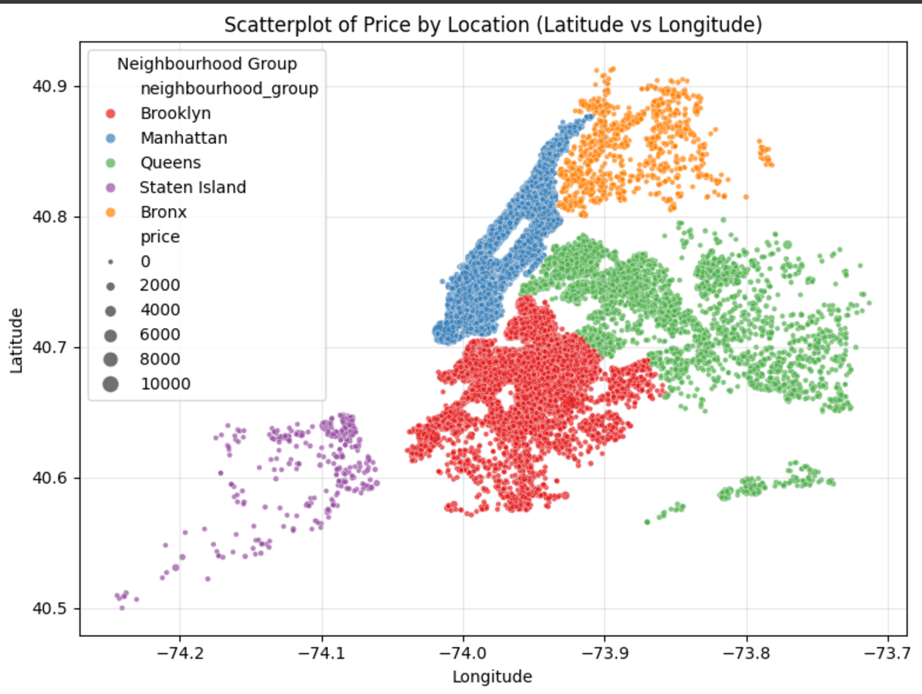
Scatterplot of Price by Location
This scatterplot highlights the concentration of high-priced Airbnb listings in Manhattan, while the other boroughs—particularly Queens, Bronx, and Staten Island—offer more budget-friendly options. It also shows how geography strongly influences listing prices.
It also highlights distinct clusters for each neighbourhood group, reflecting the spatial distribution of listings across NYC.
Distinct neighbourhood-level clusters, like Manhattan, is dense and luxury-focused, Brooklyn shows a wider and diverse spread, Queens is dispersed around transit hotspots, the Bronx has a smaller focused cluster, and Staten Island is sparse and suburban with a niche market.

Slide 19

Finding statistically significant relationships
Is there a significant statistical relationship between the following?:
Price and Room Types
Price and Availability
Ho:
There is no significant statistical relationship between price and room types/availability
Ha:
There is a statistically significant relationship between price and room types/availability
P - Value

Slide 20
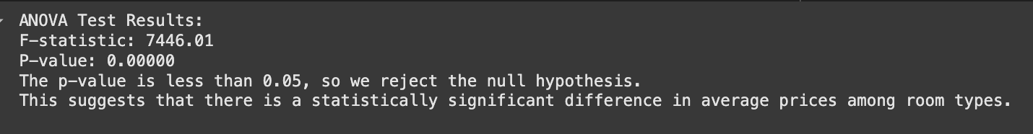
ANOVA Test on Price and Room Types
Since the p-value is less than 0.05, we reject Ho (the null hypothesis). This indicates that at least one room type has an average price significantly different from others
Since the F-statistic is large, it signifies variance in room prices by difference room types. It tells us that at least one of the room types has a significantly different average price.
There is strong statistical evidence that room type affects price in the dataset.

Slide 21
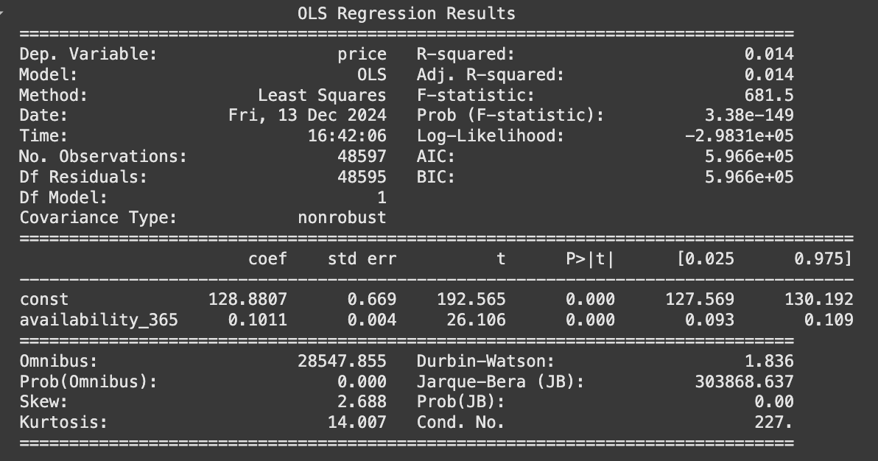
Regression on Price and Availability
Since the p-value for availability_365 is less than 0.05, we reject Ho (the null hypothesis). This suggests that availability_365 has a statistically significant relationship with price.
While availability_365 is statistically significant, it has a very small impact on predicting price in the overall dataset since the R-squared value is 0.014. Other factors likely play a larger role.

Slide 22

Key Findings: Room Types
Entire Home/Apt: This category has the highest average price and significant price variability. It caters to travellers seeking privacy and luxury.
Shared Rooms: These are the most affordable and stable in pricing, targeting budget-conscious travelers.
Private Rooms: These represent a mid-range option with moderate variability, balancing cost and comfort.

Slide 23

Key Findings: Availability
Manhattan and Brooklyn show low availability, indicating high demand and limited supply.
Staten Island and Queens exhibit higher availability, likely due to lower demand or more year-round rentals.
The Bronx shows lower availability compared to Staten Island and Queens, likely reflecting fewer listings or less active participation in the Airbnb market.

Slide 24

Key Findings: Boroughs
Manhattan dominates pricing across all room types, reflecting its premium status and high demand.
Brooklyn strikes a balance between luxury and affordability, appealing to a diverse audience.
Queens and Bronx offer the most affordable options, with Queens providing more availability.
Staten Island shows varied pricing but caters to a niche market with less competition.

Slide 25

Key Findings: Stay Patterns
Short-term stays (1-2 nights) dominate the market, highlighting Airbnb's focus on catering to travellers with brief itineraries.
Longer stays (3 nights or more) account for a smaller proportion of bookings, indicating lower demand or host preferences for short-term rentals.

Slide 26

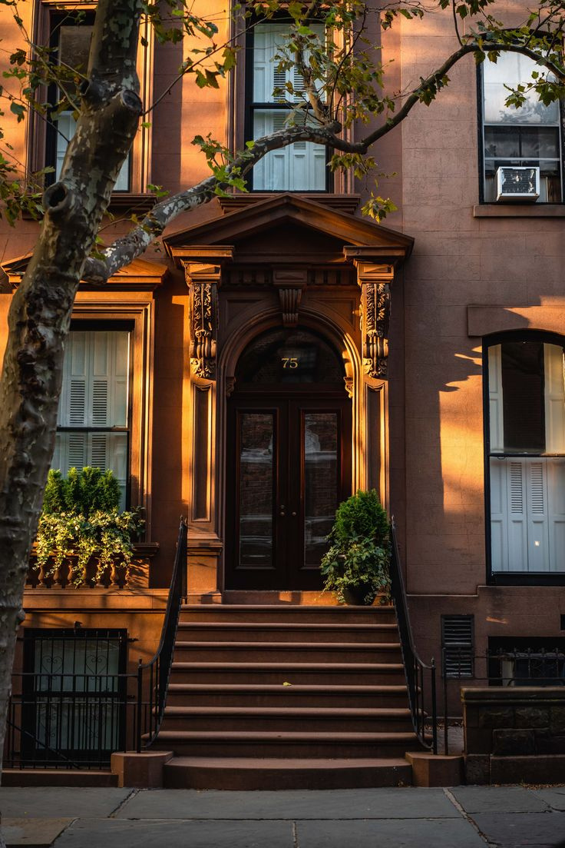
Conclusion
The analysis provides critical insights into how various factors influence Airbnb listings in NYC:
Market Segmentation: Entire homes target luxury travellers, while shared rooms cater to budget-conscious guests.
Geographical Trends: Location significantly impacts pricing, with Manhattan commanding the highest rates due to desirability.
Demand Patterns: Short-term stays and lower availability in premium boroughs highlight high demand, while outer boroughs provide affordable alternatives with more flexibility.

Slide 27

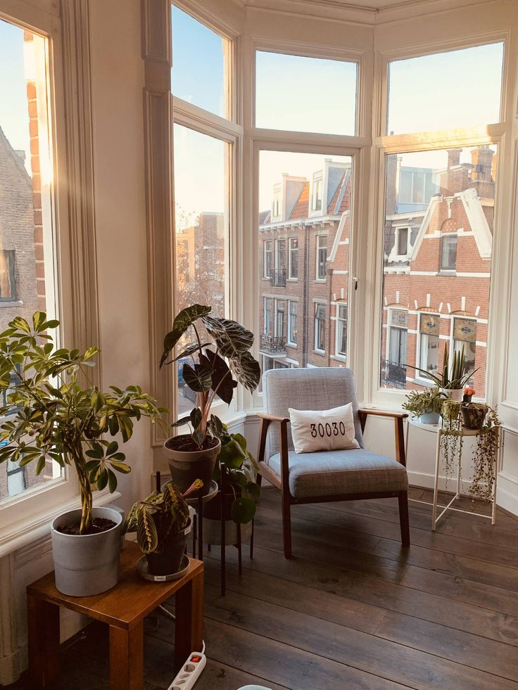
Recommendations
For Hosts: Adjust pricing based on room type and location to maximize occupancy and revenue. Leverage data insights to cater to specific traveller segments (e.g., budget-conscious vs. luxury travellers).
For Travellers: Consider boroughs like Queens and the Bronx for budget-friendly options. Opt for private rooms as a cost-effective alternative to entire homes.
This analysis can guide property management decisions, marketing strategies, and travel planning, ensuring optimal utilization of Airbnb's NYC market potential.

